Slide 1
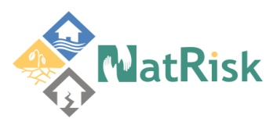


Development of master curricula for natural disasters risk management in Western Balkan countries
EU examples of students’ internships organization
Óbuda University
Dr. Erzsébet Ancza
06 Sept 2018
Project number: 573806-EPP-1-2016-1-RS-EPPKA2-CBHE-JP
"This project has been funded with support from the European Commission. This publication reflects the views only of the author, and the Commission cannot be held responsible for any use which may be made of the information contained therein"

Slide 2
Óbuda University
Donát Bánki Faculty of Mechanical and Safety Engineering
Development of master curricula for natural disasters risk management in Western Balkan countries
Educational programs of the Faculty
  Mechanical engineering (BSc, MSc)
    CAD/CAM
    Machine construction
    Vehicles engineering specializations
  Mechatronics (BSc, MSc, in English as well)
  Safety engineering (BSc, MSc)
  Security and safety sciences (PhD)

Slide 3
New institution development project
Development of master curricula for natural disasters risk management in Western Balkan countries
Key element (beside other elements):
Practice-oriented training efforts
Students should spend as much time as possible on industrial field during their studies
Not only the compulsory internship

Slide 4
Practice-oriented training efforts
Development of master curricula for natural disasters risk management in Western Balkan countries
How to find companies who want to employ student?
The demand for engineers has increased a lot in Hungary during the past years.
Generally the companies contact us.
Students can also suggest companies.

Slide 5
Practice-oriented training efforts
Development of master curricula for natural disasters risk management in Western Balkan countries
Different types of cooperation:
Compulsory internship (6 weeks at BSc, 4 weeks at MSc level)
Project work subject proposal (+supervisor)
Thesis/diploma work subject proposal
Dual training
Cooperative training
Research and development cooperation

Slide 6
Practice-oriented training efforts
Development of master curricula for natural disasters risk management in Western Balkan countries
At the end of the internship:
Recognition of the completion (company)
Competence assessment (company)
Report (student)

Slide 7
Dual training
Development of master curricula for natural disasters risk management in Western Balkan countries
Hungarian universities introduced the dual study model based on German experience in 2015.
The Hungarian Higher Education Act was amended in 2014 and it defined the role and place of this new form of training in higher education.

Slide 8
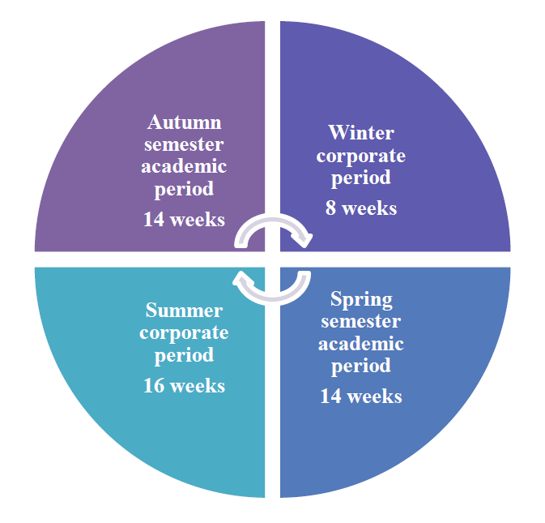
Dual training
Development of master curricula for natural disasters risk management in Western Balkan countries
Students in dual education perform during the study period together with the normal full-time students in their higher education institute.
After this period they participate in the practical training at an enterprise which has a cooperation contract with the University.

Slide 9
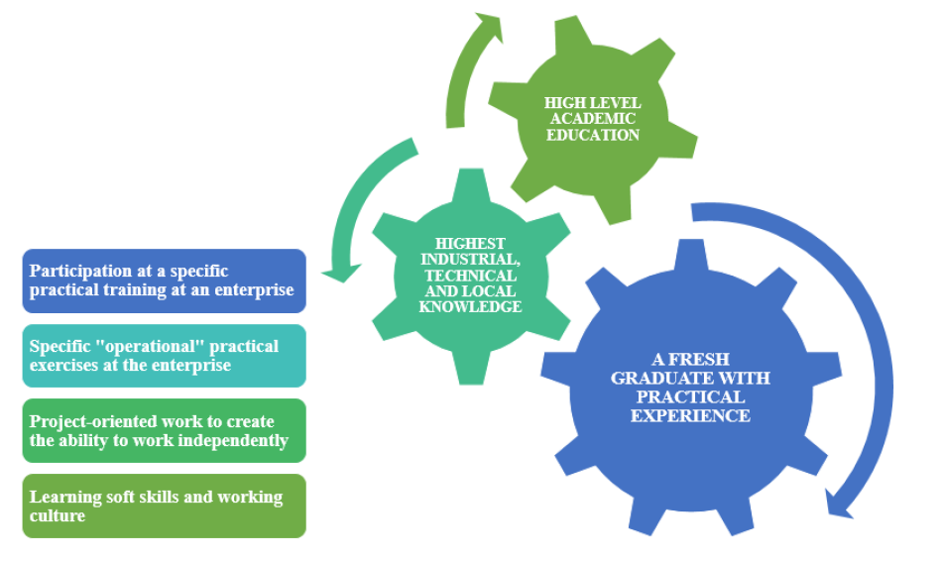
Dual training
Development of master curricula for natural disasters risk management in Western Balkan countries

Slide 10
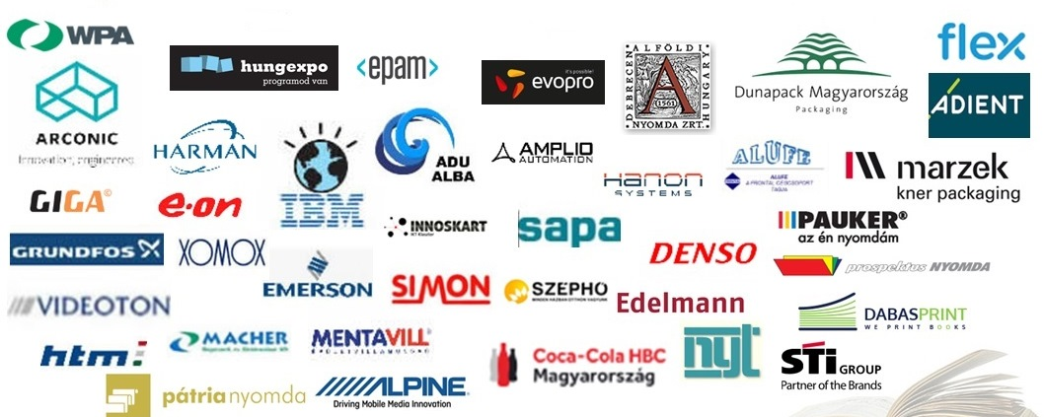
Dual Partners of OU
Development of master curricula for natural disasters risk management in Western Balkan countries

Slide 11
The dual form of training can be beneficial for all the three sides: students, companies and universities.
Win-win-win situation
Development of master curricula for natural disasters risk management in Western Balkan countries

Slide 12
Students‘ side
Development of master curricula for natural disasters risk management in Western Balkan countries
They can gain practical knowledge during their studies, which helps them to get a position after training,
The income from the work can be used to finance their training more easily.
However, this type of training requires a certain degree of maturity, high level of motivation, because the coordination of work and study is difficult.

Slide 13
Companies side
Development of master curricula for natural disasters risk management in Western Balkan countries
Active participation in the training process of students who were selected by themselves.
They can be flexible in what to teach, considering their own needs.
Long-term investment

Slide 14
University‘s side
Development of master curricula for natural disasters risk management in Western Balkan countries
More motivated students
Active cooperation with an enterprise; R&D
Social awareness and recognition

Slide 15
Cooperative training
Development of master curricula for natural disasters risk management in Western Balkan countries
Definition: students who have only a thesis (or up to 1-2 subjects) from their studies, spend 4 days a week at a particular company and fulfill their study obligations one day in the Institute.
Objective: to acquire students' professional practice in real industrial condition.
Cooperative training consists of students attending the University part-time and work part-time (4 days at the company + 1 day at the University).
Available benefit: The payment amount varies depending on the company, and are issued monthly.

Slide 16
Benefits for Students
Development of master curricula for natural disasters risk management in Western Balkan countries
The payment amount varies depending on the company, and are issued monthly.
Real long term (5 or 10 months) work in a professional field
30 credits can be gained
The company offers real problem to solve in thesis work and provides the supervisor
In case of successful cooperation, the company may also offer a job.

Slide 17
Benefits for Companies
Development of master curricula for natural disasters risk management in Western Balkan countries
„Almost“ professionals with favourable financing
Getting involved in training process
Well-trained staff of their choice

Slide 18
Benefits for the Institution
Development of master curricula for natural disasters risk management in Western Balkan countries
Feedback from the industry about the quality of its workforce, the quality of the education.
Financial benefits: during the training time the student remains at the university in student status.
The firm and the faculty make a training contract. The training is financially supported by the company (ie. pay to the university and not to the student). 60%-40%

Slide 19
Development of master curricula for natural disasters risk management in Western Balkan countries
THANK YOU FOR YOUR ATTENTION

